Slide 1



Slide 2


CODE VERSE HACKATHON 2025
Problem Statement:- Build an AI tool that helps legal professionals rapidly search, sort, and summarize massive document dumps.
Domain:- General
Team Name:- Generational Gap
Team Members:- Harshal Kale, Sidharth Maharana, Shiv Tangloo

Slide 3
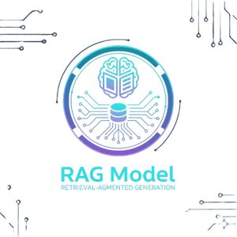

OUR SOLUTION
RAG
+
VERTEX AI
=
LEGALIFY
Combines language models with retrieval to generate accurate, context-based answers from legal documents.
Dynamically pulls relevant document sections to ground summaries and answers in facts.
Supports interactive Q&A and provides source references to enhance trust and explainability.
Provides scalable, secure infrastructure for training and deploying legal AI models.
Orchestrates complex NLP pipelines integrating retrieval, summarization, and chatbot functionalities.
Monitors and manages model performance, ensuring reliability and compliance with data security.
Legalify summarizes complex legal documents efficiently and accurately.
It explains legal jargon in simple terms to enhance user understanding.
Provides interactive, document-based answers with references for transparency.
Offers personalized summaries tailored to the user’s context, ensuring relevance and clarity.

Slide 4
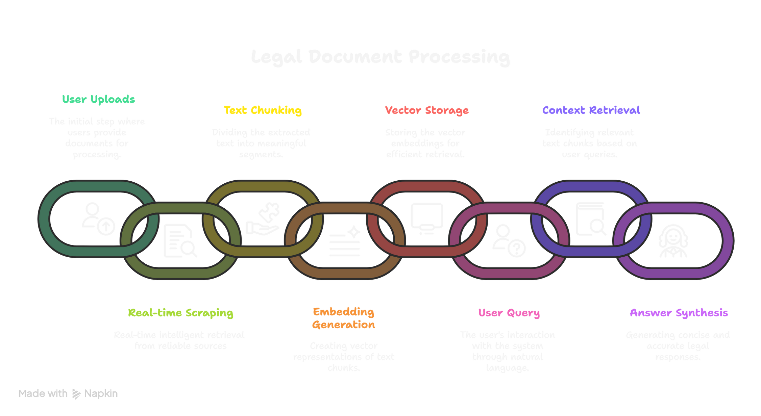
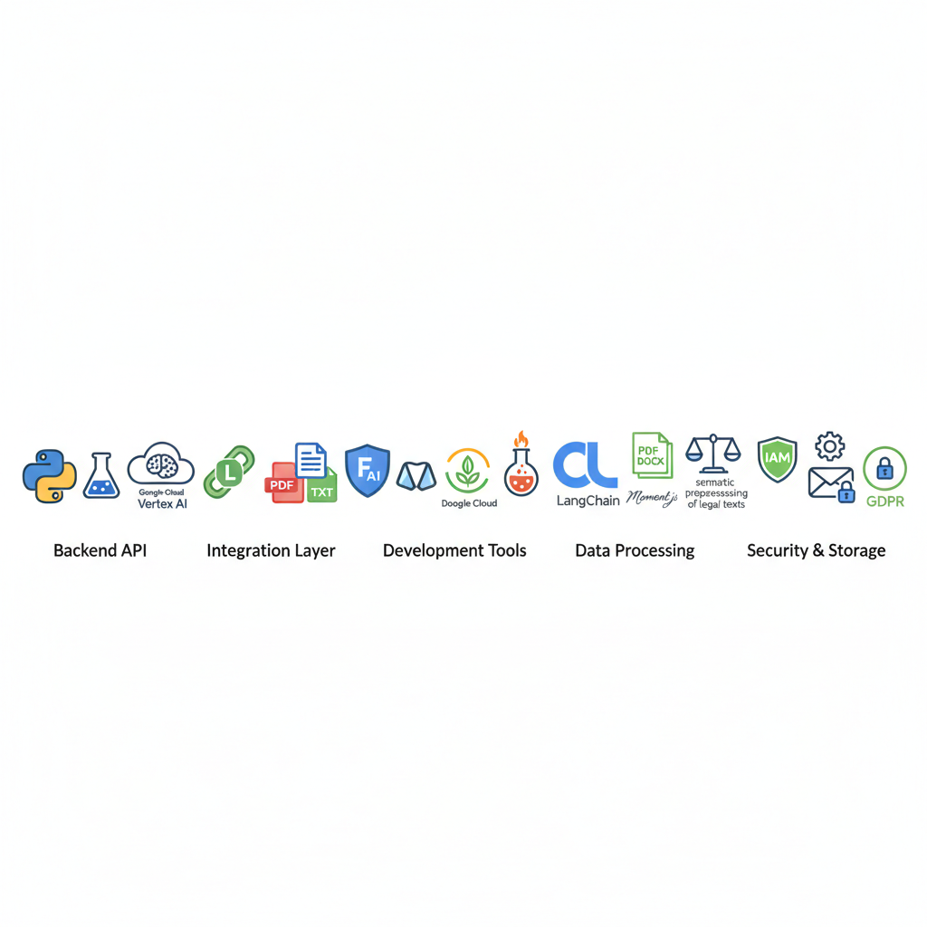
TECHNICAL APPROACH

Slide 5

FEASIBILITY AND VIABILITY
Analysis of the Feasibility
Large availability of diverse open-source and proprietary legal datasets supports model fine-tuning
RAG-based methodology aided by Google Custom Search Engine ensures better accuracy and minimizes hallucinations, making it practical for legal use..
Challenges
Strategies
Human-in-the-loop validation and transparent source referencing
Continuous fine-tuning on varied legal datasets and formats
Optimize cloud usage with auto-scaling and efficient resource allocation
Risk of inaccurate or misleading summaries
Handling diverse legal documents across jurisdictions
High infrastructure and scaling costs

Slide 6
IMPACT AND BENEFITS
Potential Impact
Faster Legal Research – Reduce hours of manual reading to minutes
Improved Accessibility – Complex laws explained in simple terms
Higher Accuracy – Minimize human error in interpretation
Secure & Private – Trustworthy handling of sensitive documents
Enhanced Decision-Making – Quick access to relevant legal insights
Broader Reach – Enables individuals without legal background to understand document
Prioritized Insights – Google Custom Search Engine enables focus on high-profile litigations for more relevant results
Benefits
Time-Saving for Lawyers & Clients – Reduces research and reading time
Easy to Use Even Without Legal Knowledge – User-friendly for all users
Boost Productivity in Legal Workflows – Streamlines legal document handling
Scalable Solution for Enterprises & Individuals – Works for any user size
Interactive Chat Interface for Instant Answers – Ask questions, get quick responses
Multi-Format Document Support (PDF, DOCX, TXT) – Handles all common legal formats

